Slide 1
DATA COMMUNICATION AND NETWORKING LAB-(CAP276)
NAME-AYUSH MISHRA
ROLL NO-DOC14A17
REG.NO-12221739
CA-1 PRACTICAL

Slide 2
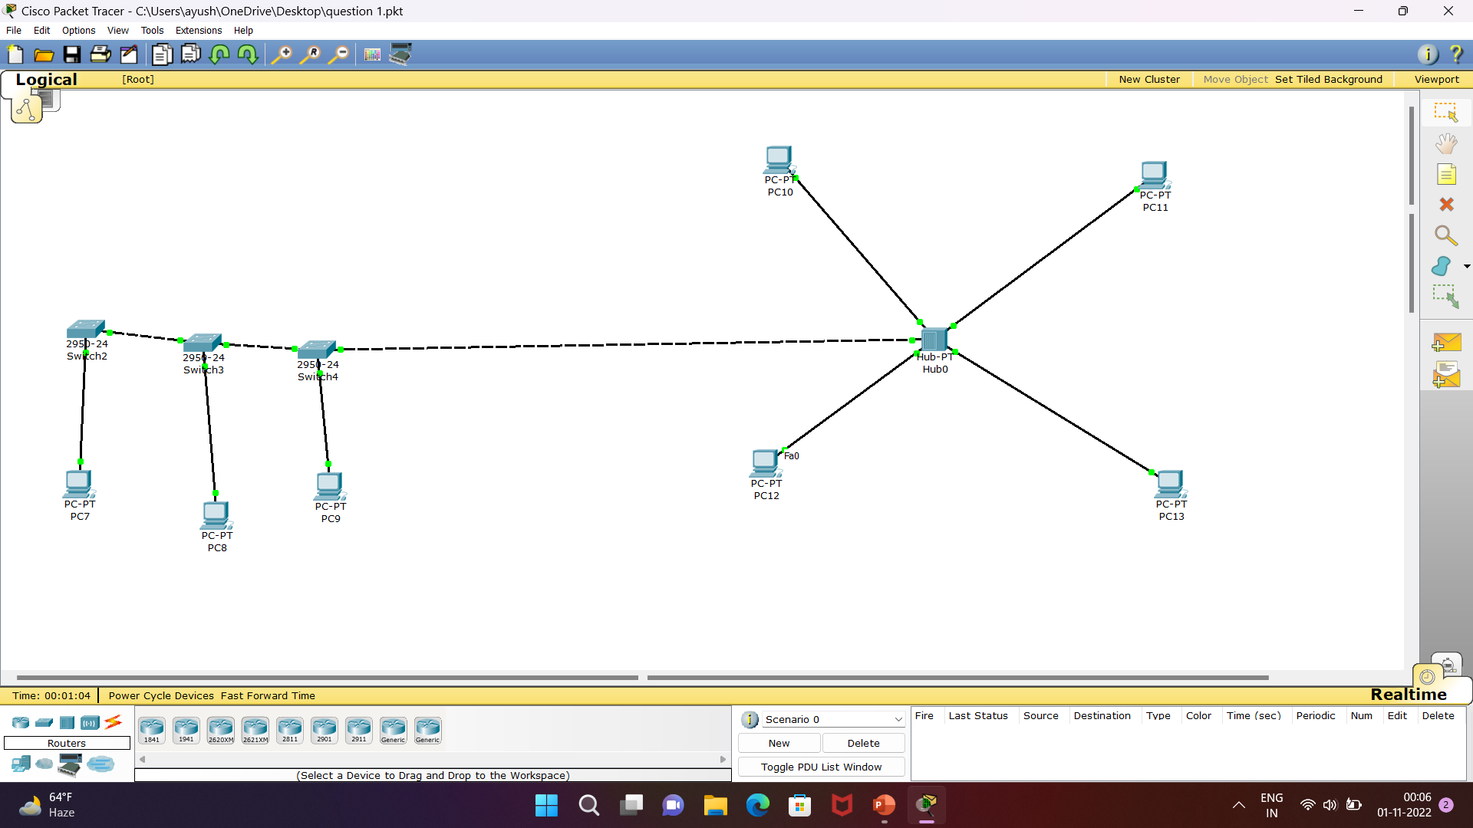
Question 1:Design hybrid network using star and bus topology.configure if with ip address

Slide 3
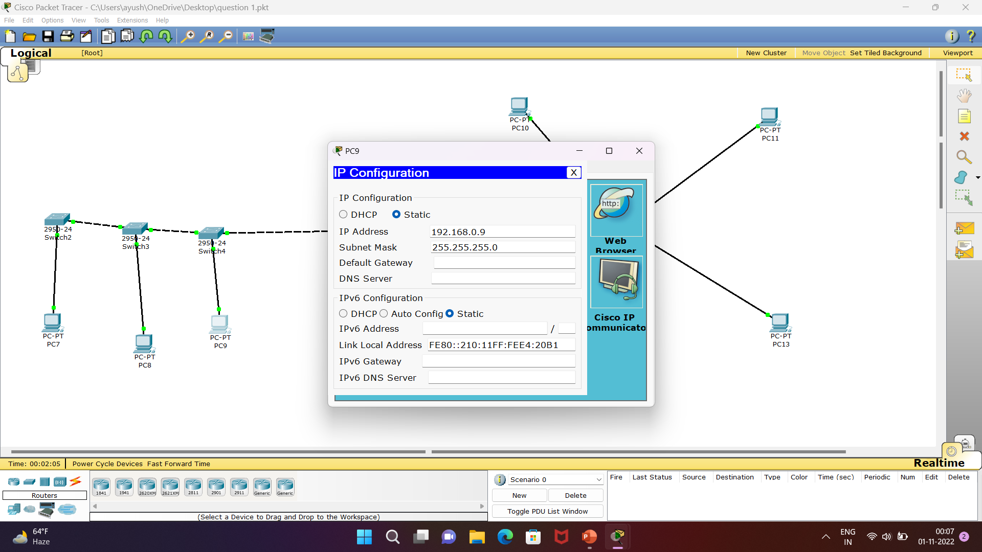

Slide 4
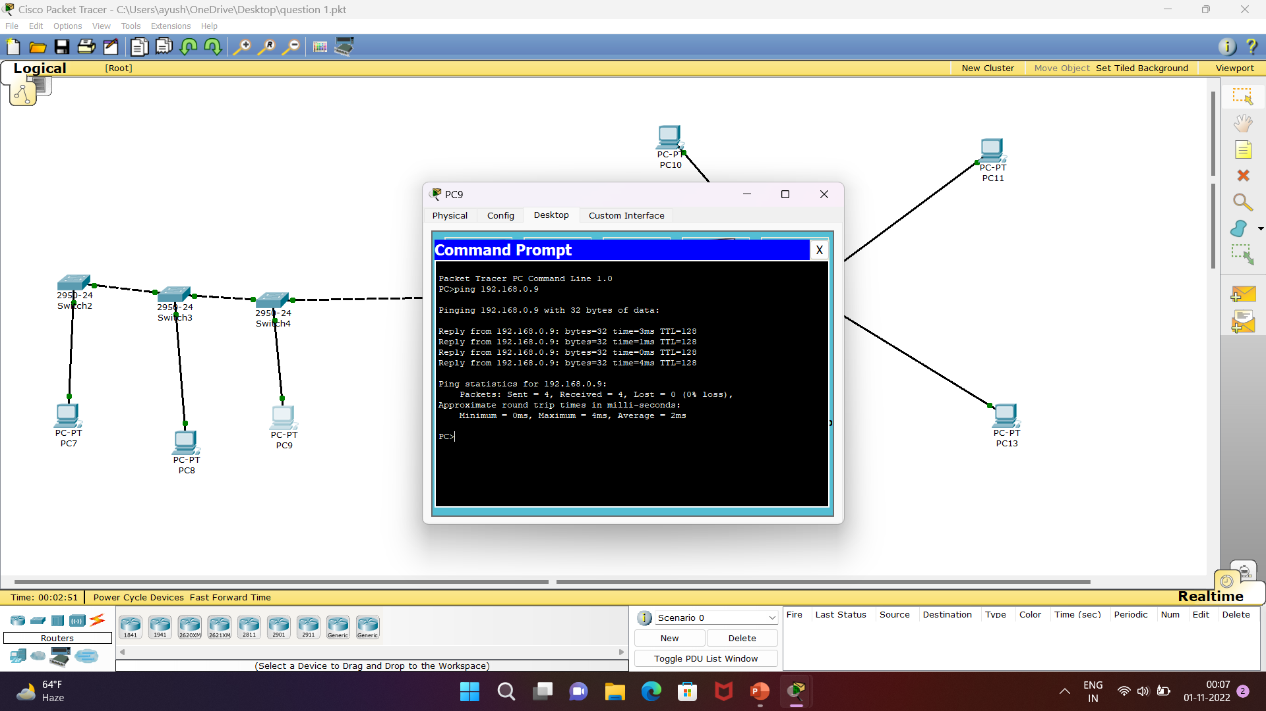

Slide 5
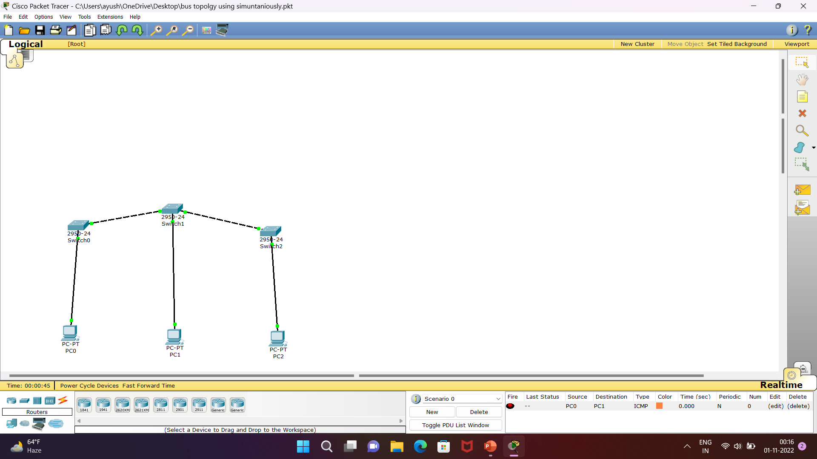
Question 2: Design a bus topology with network id’s192.168.0.2,192.168.0.3,,192.168.0.4,ping it commond prompt.Also send the pdu in real time and simunlation mode.

Slide 6
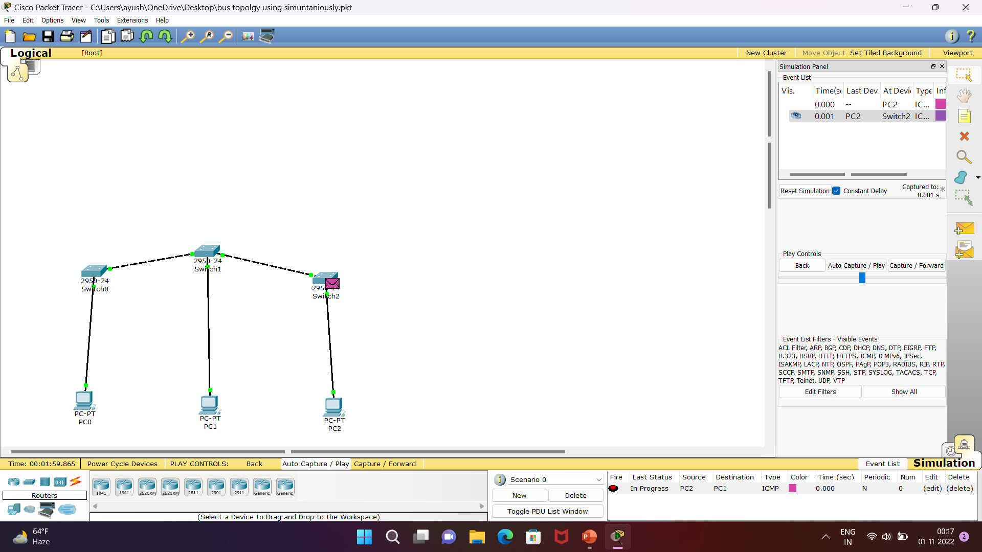
Add simple pdu and sending the message to another port in progress

Slide 7
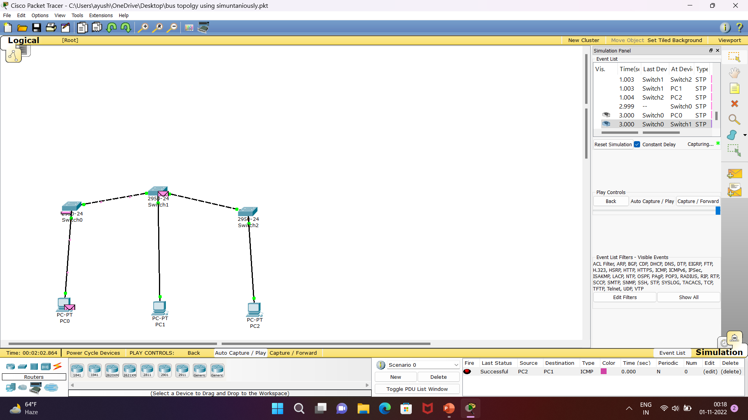
Sucessful send the pdu in simulation mode

Slide 8
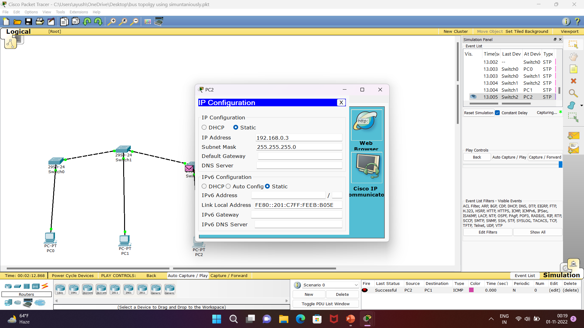
configure

Slide 9
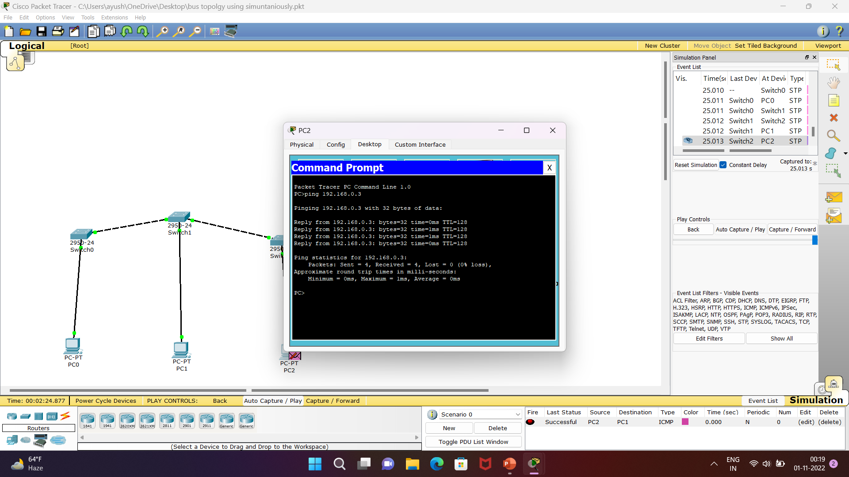
ping

Slide 10
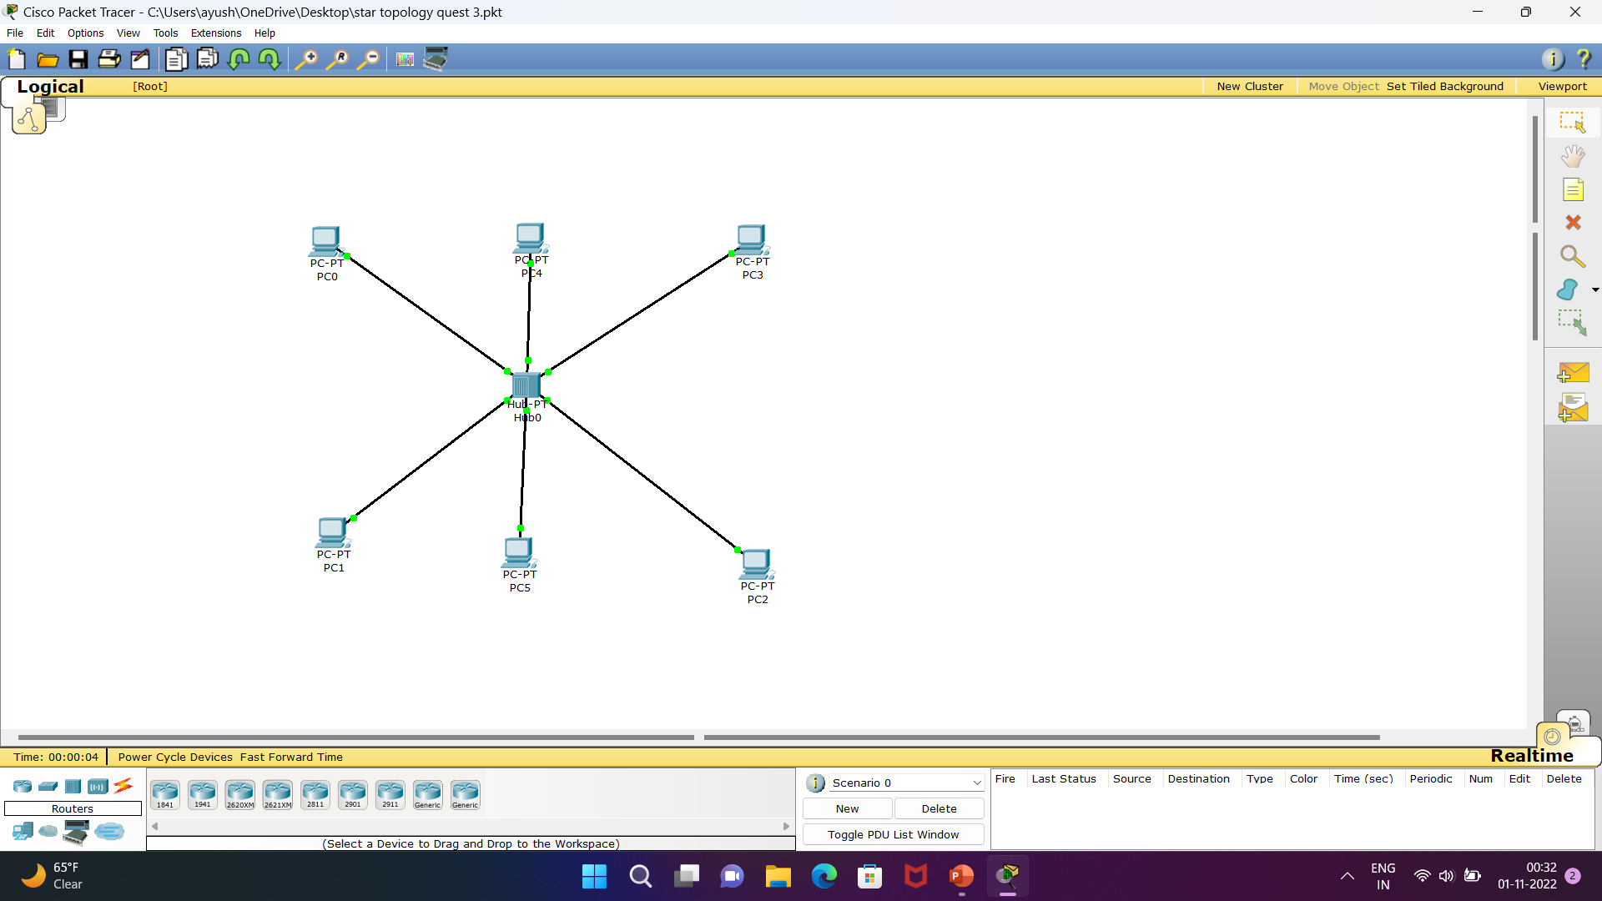
Question 3: Implememt star topology using hub.Configure it with 10.10.10.1 also check the connectivity using ping command.

Slide 11
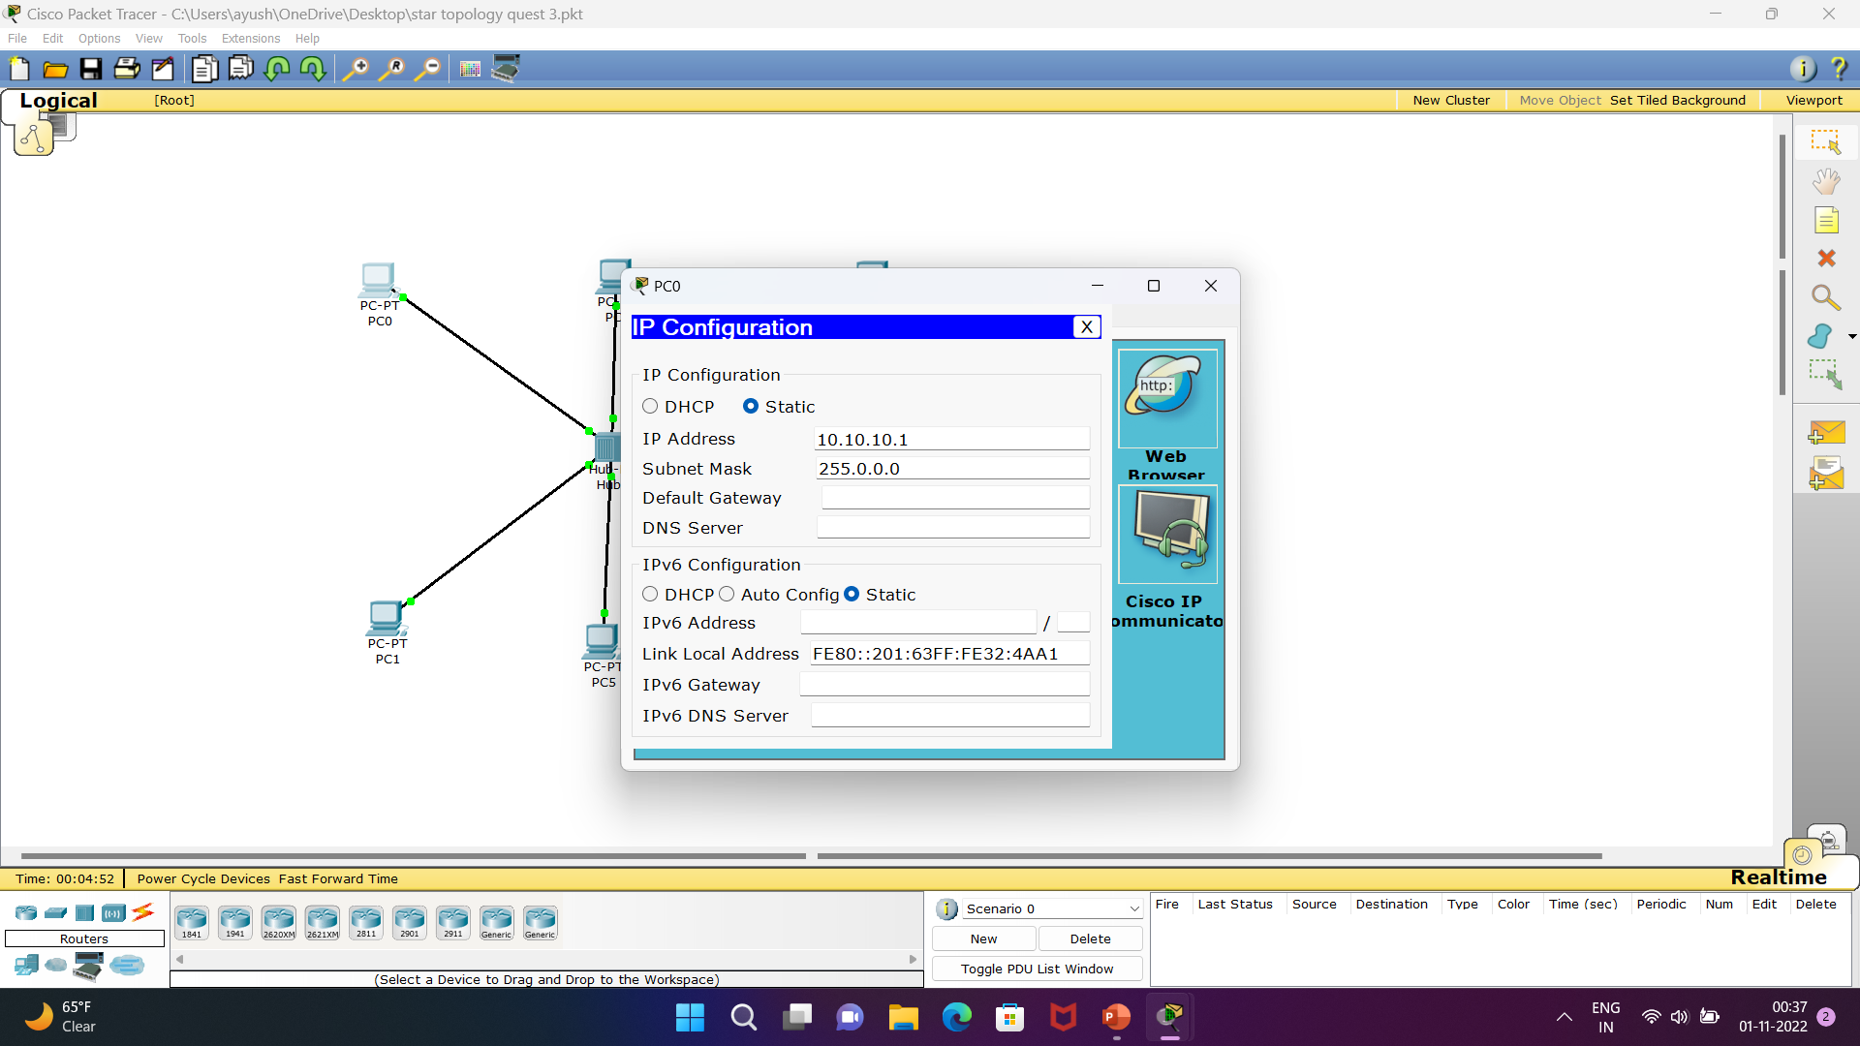
Configure pc with 10.10.10.1

Slide 12
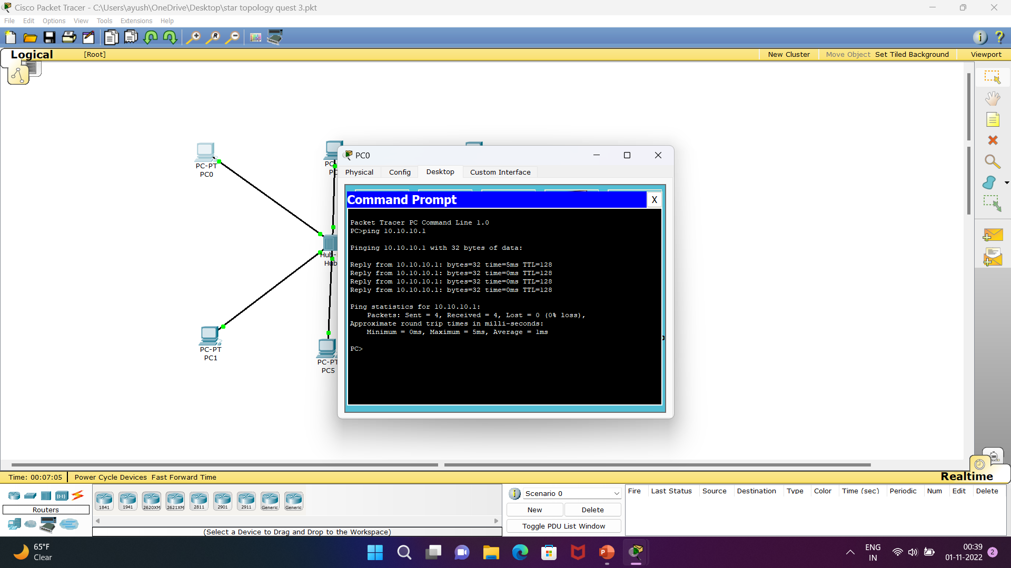
Ping command prompt

Slide 13
THANK YOU

